Slide 1
Metric and Dashboard
Metric Is and Isn’t
About Metric Data
Design and Deployment
webmaster@xqbase.com

Slide 2
Content
Metric Is and Isn’t
Comparison of Monitoring Systems
Comparison between Log and Metric
About Metric Data
Design and Deployment

Slide 3
Comparison of Monitoring Systems
OS-Level Monitoring
Zabbix, Nagios, Cacti, etc.
App-Level Monitoring
Client Side: Google Analytics, Piwik, Umeng.com, etc.
Server Side: Metric / Dashboard
CPU
Memory
Disk
Network
Processes
…
Conn. Pools
API Callings
Business Data
User Behaviors
Orders
…
Requests
Connections
Threads
…
OS-Level Mon.
App-Level Mon.

Slide 4
Client Mon. vs Server Mon.
Client Monitoring
User Visits / Page Visits
User Statistics (Origins, Demographics, Platforms, etc.)
User Behaviors (Timing, Conversions, Retentions, etc.)
Not Accurate ☹
Server Monitoring
+ Server / Web Health (Load, Conn. Pools, API Callings, etc.)
+ Business Data (Visits, Orders, Transactions, etc.)
Accurate ☺

Slide 5
Comparison between Log and Metric
Log
Each Event into Storages (File or DB)
Huge Size
Metric
Only Aggregated Data into Storages
Stored by Minute
Limited Size (Limited Tags and Values)
Statistics
From Logs (Aggregation Pipeline, Map-Reduce, …)
From Metrics (Aggregation Pipeline, Map-Reduce, …)

Slide 6
Content
Metric Is and Isn’t
About Metric Data
Tags
Aggregations
Design and Deployment

Slide 7
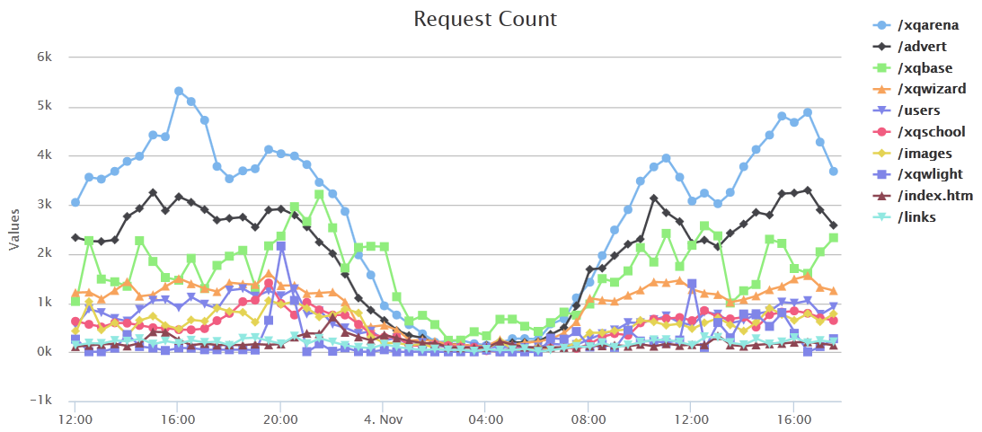
Dashboard
Tag: Path

Slide 8
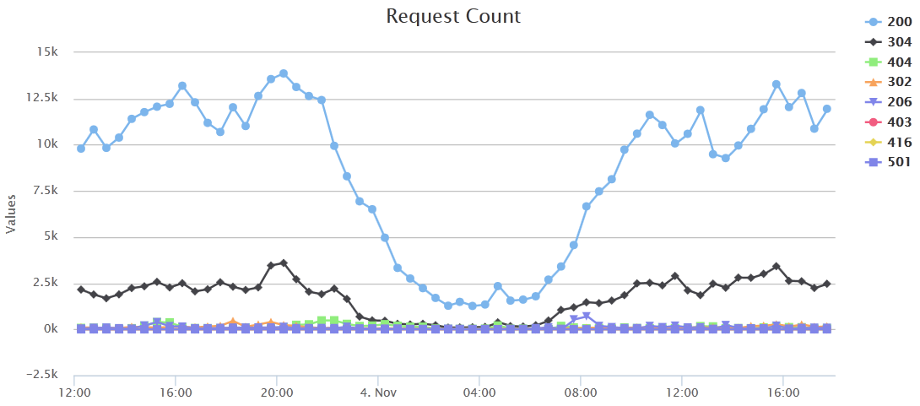
Dashboard
Tag: Status

Slide 9
Tags
Tags are Attributes
{_minute=“12:10:02”, path=“/”, status=200},
{_minute=“12:10:23”, path=“/users/”, status=200},
{_minute=“12:10:54”, path=“/”, status=200},
{_minute=“12:11:30”, path=“/users/”, status=200},
…
Tags are Columns
_minute | path | status | _count
12:10:00 | / | 200 | 2
12:10:00 | /users/ | 200 | 5
12:11:00 | / | 200 | 4
12:11:00 | /users/ | 200 | 3
12:11:00 | /users/ | 304 | 1

Slide 10
Tag Is and Isn’t
Query Condition
WHERE tag_name = tag_value
GROUP BY tag_name
Limited Tag Names and Values
Tag Values are NOT Log Entries
Which are Bad Tags?
Server IP
Client IP
Content-Type
User Agent
☺
☹
☺
☹

Slide 11

Aggregation Methods
Process
Method
COUNT
SUM
MAX / MIN
AVG
STD
Scenarios
CPU Load, Memory
Network Throughput
Connections
Request
Response Time
Orders
MAX, AVG
SUM
MAX
COUNT
MAX, AVG
COUNT, SUM

Slide 12
Aggregation Algorithms
Accumulate
Supply
var entry = {
count: 1,
sum: value,
max: value,
min: value,
sqr: value * value,
};
Combine
count = sum(entries[i].count);
sum = sum(entries[i].sum);
max = max(entries[i].max);
min = min(entries[i].min);
sqr = sum(entries[i].sqr);
avg = sum / count;
std = sqrt(sqr * count – sum * sum) / count;
entry.count ++;
entry.sum += value;
entry.max = max(entry.max, value);
entry.min = min(entry.min, value);
entry.sqr += value * value;

Slide 13
Content
Metric Is and Isn’t
About Metric Data
Design and Deployment
Design
Deployment
Aggregation Phases

Slide 14
Design
Collect
Text + zlib + UDP --- Simple and Never Block
Store
MongoDB --- Arbitrary Tags and Easy to Query
Query
HTTP Rest API + JSON Data --- Easy to Develop Dashboard Apps

Slide 15
Aggregation Phases
Aggregation before Collection
For Java and C# Websites
Aggregates on Web Server (by Minute)
Aggregation during Collection
For PHP Websites
Aggregates on Collector (by Minute)
Aggregation during Query
For Dashboard Apps (Dashboard, Alerting, BI, …)
Aggregates on Query Server (by Tags)

Slide 16
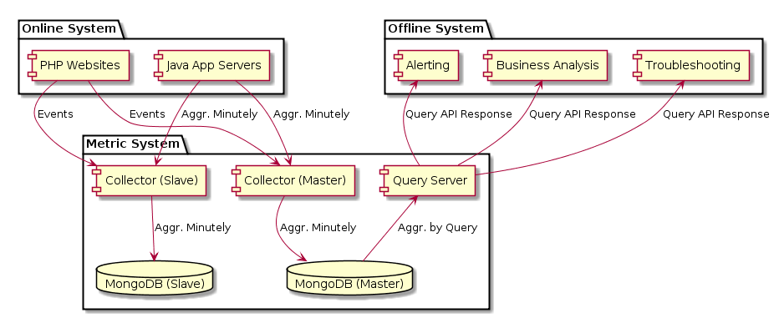
Deployment

Slide 17
Thanks
Metric and Dashboard
Metric Is and Isn’t
About Metric Data
Design and Deployment
webmaster@xqbase.com

